Slide 1
Figures by species
Present – seasonal maps, 2 depths
Future 245 – seasonal maps, 2 depths
Future 585 – seasonal maps, 2 depths
Future 245 – decadal and hovmuller
Future 585 – decadal and hovmuller

Slide 2
Dungeness Crab

Slide 3
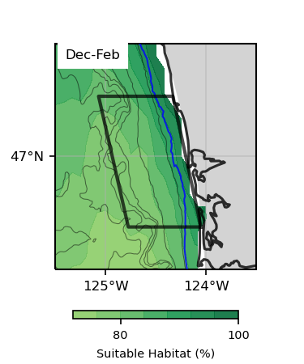
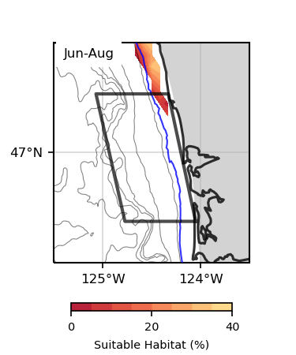
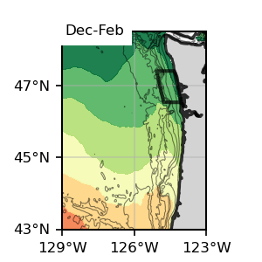
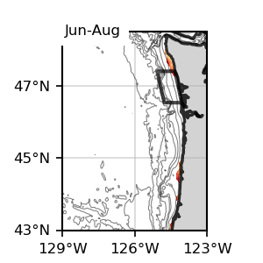
Surface
Surface
Dungeness Crab
Surface, present SSP245
1993-2019

Slide 4
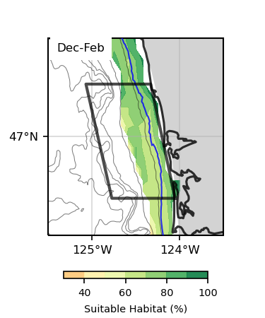
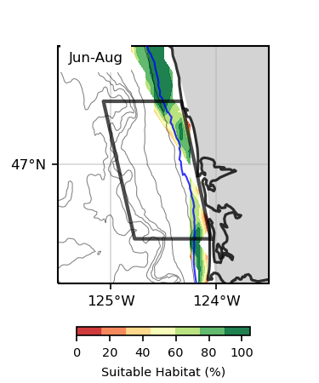
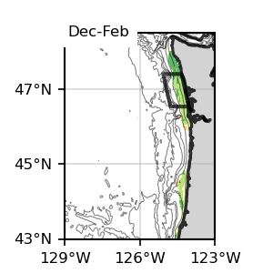
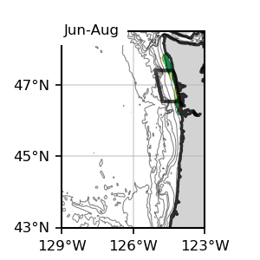
Bottom
Bottom
Dungeness Crab
Bottom, present SSP245
1993-2019

Slide 5
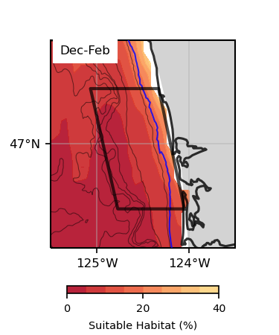
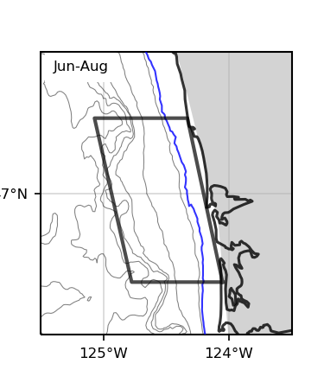
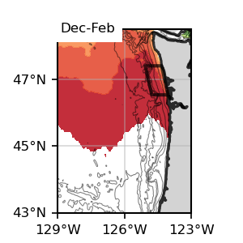
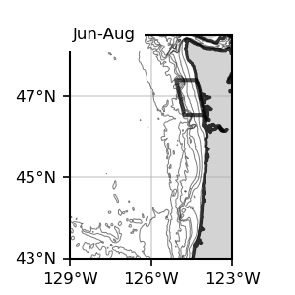
Surface
Surface
Dungeness Crab
Surface, Future, SSP 245
2060-2080

Slide 6
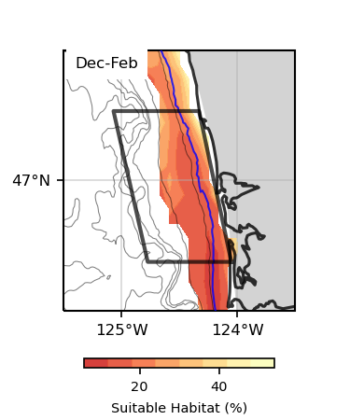
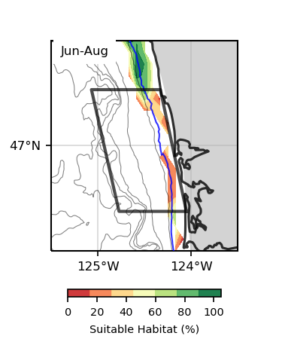
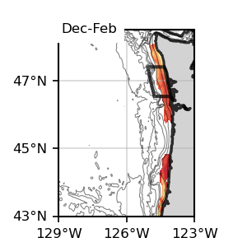
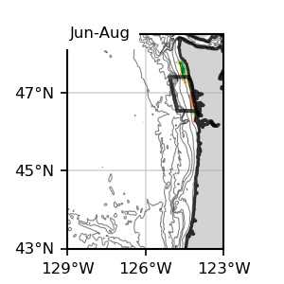
Bottom
Bottom
Dungeness Crab
Bottom, Future, SSP 245
2060-2080

Slide 7
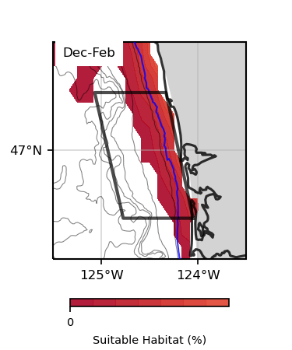
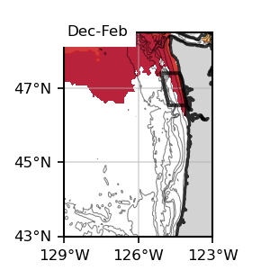
Surface
Surface
Dungeness Crab
Surface, Future, SSP 585
2060-2080

Slide 8
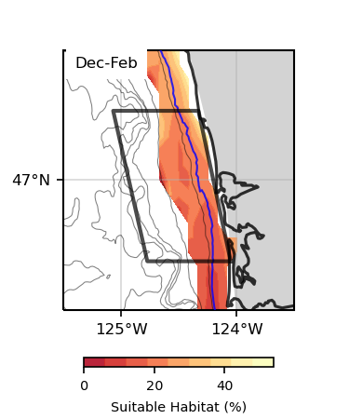
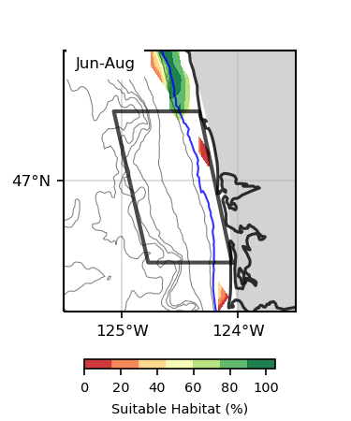
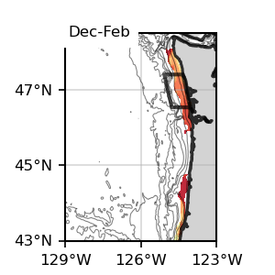
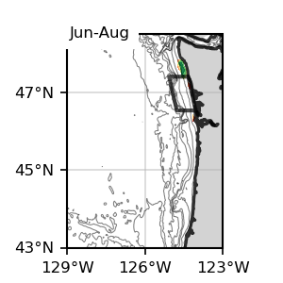
Bottom
Bottom
Dungeness Crab
Bottom, Future, SSP 585
2060-2080

Slide 9
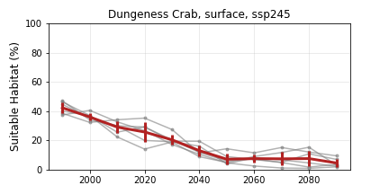
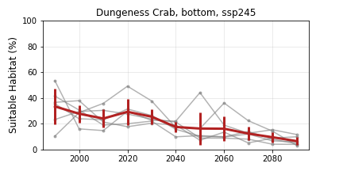
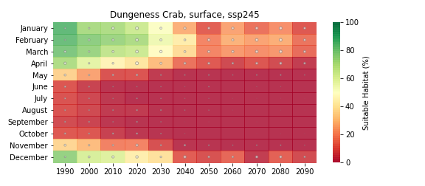
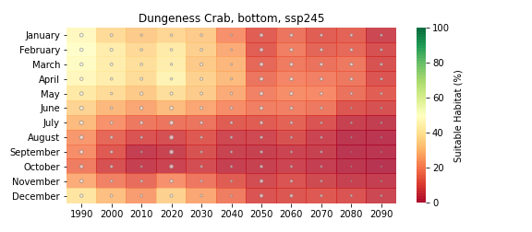
Dungeness Crab
Future, SSP 245

Slide 10
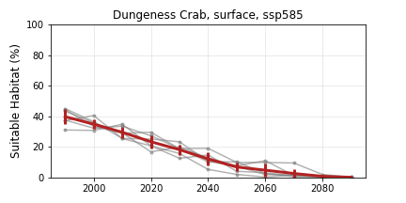
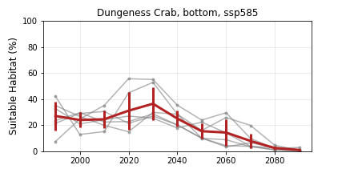
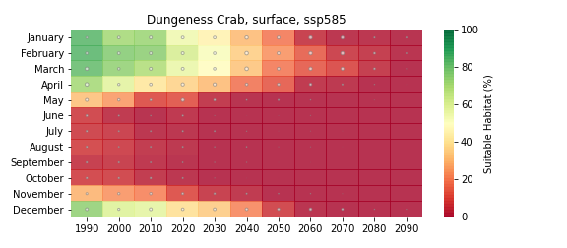
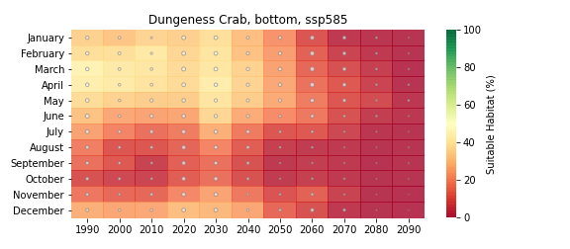
Dungeness Crab
Future, SSP 585

Slide 11
Sablefish

Slide 12
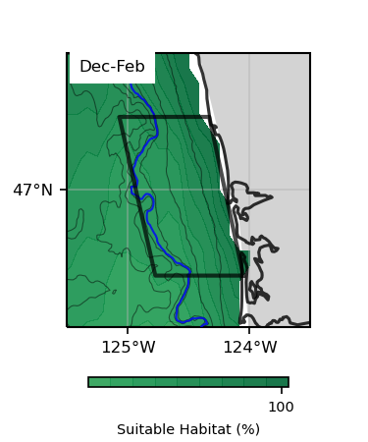
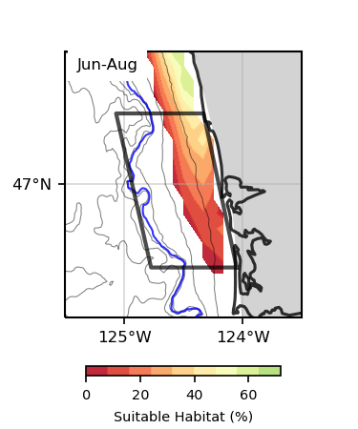
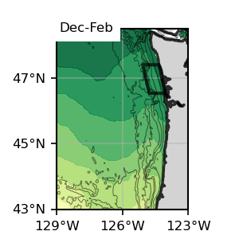
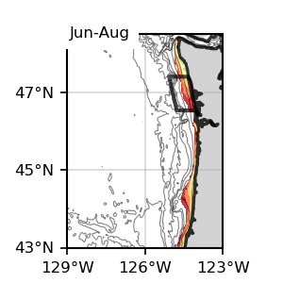
Surface
Surface
Sablefish
Surface, present SSP245
1993-2019

Slide 13
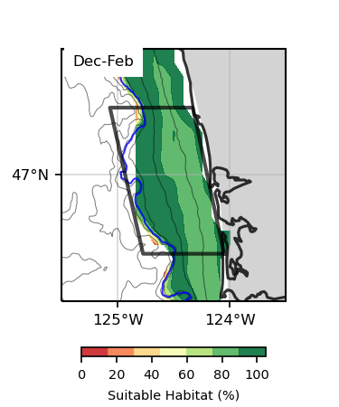
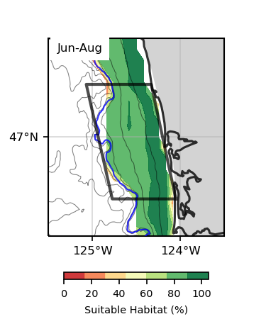
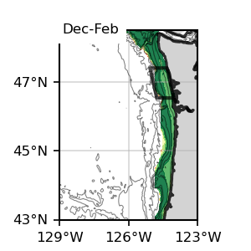
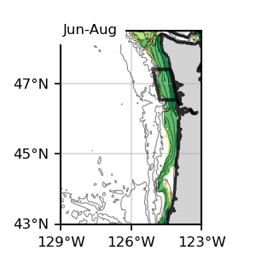
Bottom
Bottom
Sablefish
Bottom, present SSP245
1993-2019

Slide 14
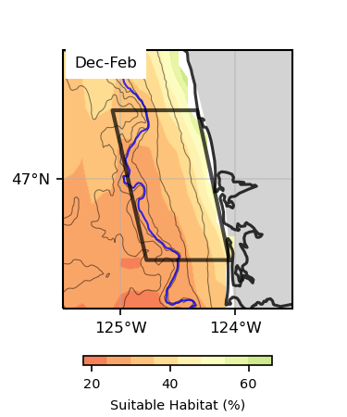
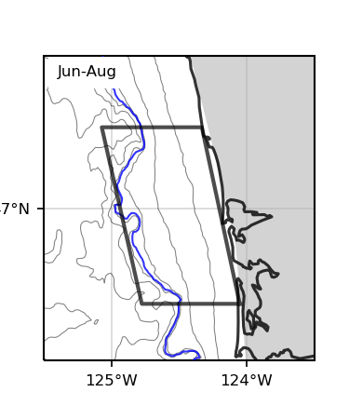
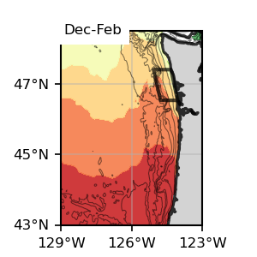
Surface
Surface
Sablefish
Surface, Future 245
2060-2080

Slide 15
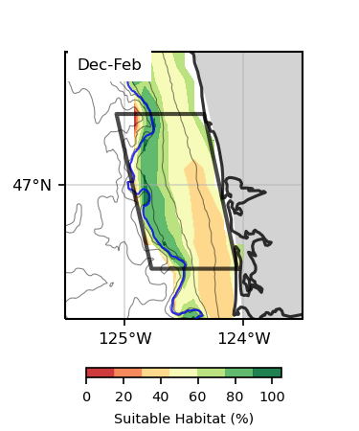
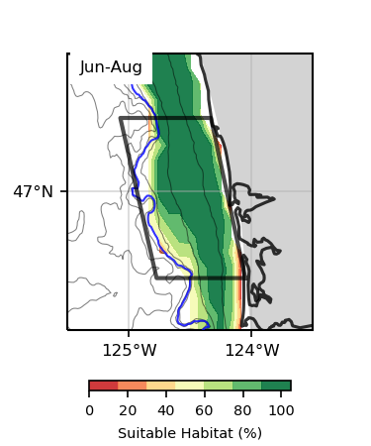
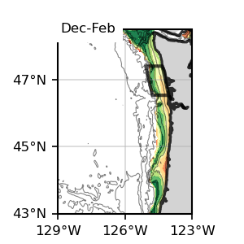
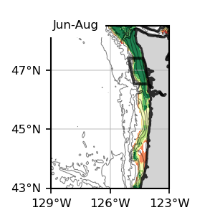
Bottom
Bottom
Sablefish
Bottom, Future 245
2060-2080

Slide 16
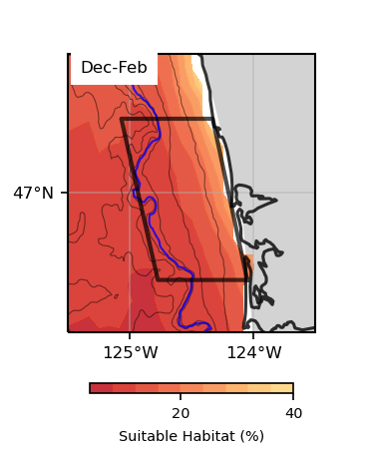
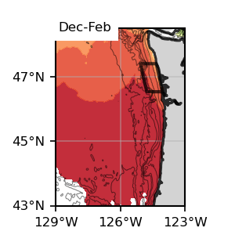
Surface
Surface
Sablefish
Surface, Future 585
2060-2080

Slide 17
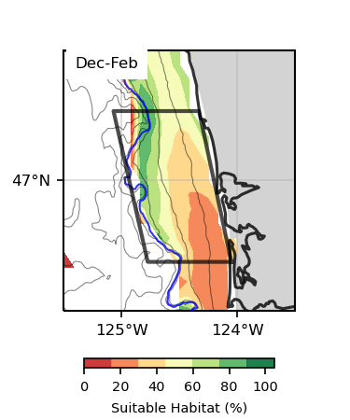
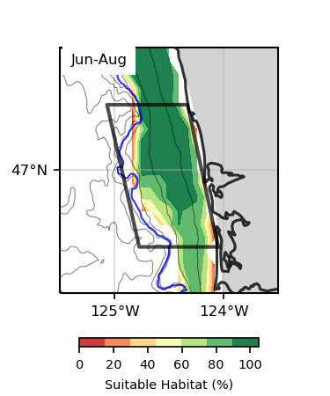
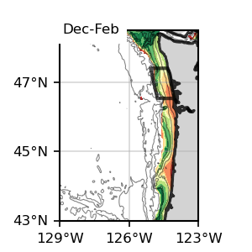

Bottom
Bottom
Sablefish
Bottom, Future 585
2060-2080

Slide 18




Sablefish
Future 245

Slide 19




Sablefish
Future 585

Slide 20
Halibut

Slide 21



Surface
Surface
Halibut
Surface, present SSP245
1993-2019

Slide 22




Bottom
Bottom
Halibut
Bottom, present SSP245
1993-2019

Slide 23



Surface
Surface
Halibut
Surface, Future 245
2060-2080

Slide 24




Bottom
Bottom
Halibut
Bottom, Future 245
2060-2080

Slide 25

Surface
Surface
Halibut
Surface, Future 585
2060-2080

Slide 26



Bottom
Bottom
Halibut
Bottom, Future 585
2060-2080

Slide 27




Halibut
Future 245

Slide 28




Halibut
Future 585

Slide 29
Chinook

Slide 30




Surface
Surface
Chinook
Surface, present SSP245
1993-2019

Slide 31




Bottom
Bottom
Chinook
Bottom, present SSP245
1993-2019

Slide 32



Surface
Surface
Chinook
Surface, Future 245
2060-2080

Slide 33




Bottom
Bottom
Chinook
Bottom, Future 245
2060-2080

Slide 34


Surface
Surface
Chinook
Surface, Future 585
2060-2080

Slide 35




Bottom
Bottom
Chinook
Bottom, Future 585
2060-2080

Slide 36




Chinook
Future 245

Slide 37




Chinook
Future 585

Slide 38
Coho

Slide 39




Surface
Surface
Coho
Surface, present SSP245
1993-2019

Slide 40




Bottom
Bottom
Coho
Bottom, present SSP245
1993-2019

Slide 41



Surface
Surface
Coho
Surface, Future 245
2060-2080

Slide 42




Bottom
Bottom
Coho
Bottom, Future 245
2060-2080

Slide 43


Surface
Surface
Coho
Surface, Future 585
2060-2080

Slide 44




Bottom
Bottom
Coho
Bottom, Future 585
2060-2080

Slide 45




Coho
Future 245

Slide 46




Coho
Future 585

Slide 47
Razor Clams

Slide 48




Surface
Surface
Razor Clams
Surface, present SSP245
1993-2019

Slide 49




Bottom
Bottom
Razor Clams
Bottom, present SSP245
1993-2019

Slide 50



Surface
Surface
Razor Clams
Surface, Future 245
2060-2080

Slide 51




Bottom
Bottom
Razor Clams
Bottom, Future 245
2060-2080

Slide 52


Surface
Surface
Razor Clams
Surface, Future 585
2060-2080

Slide 53




Bottom
Bottom
Razor Clams
Bottom, Future 585
2060-2080

Slide 54




Razor Clams
Future 245

Slide 55




Razor Clams
Future 585

Slide 56
Albacore

Slide 57




Surface
Surface
Albacore
Surface, present SSP245
1993-2019

Slide 58

Bottom
Bottom
Albacore
Bottom, present SSP245
1993-2019

Slide 59




Surface
Surface
Albacore
Surface, Future 245
2060-2080

Slide 60


Bottom
Bottom
Albacore
Bottom, Future 245
2060-2080

Slide 61




Surface
Surface
Albacore
Surface, Future 585
2060-2080

Slide 62


Bottom
Bottom
Albacore
Bottom, Future 585
2060-2080

Slide 63




Albacore
Future 245

Slide 64




Albacore
Future 585

